Slide 1
IDC 3931 – Big Data
Chapter 5:
Text and Web Mining

Slide 2
Learning Objectives
Describe text mining and understand the need for text mining
Differentiate between text mining, Web mining and data mining
Understand the different application areas for text mining
Know the process of carrying out a text mining project
Understand the different methods to introduce structure to text-based data

Slide 3
Learning Objectives
Describe Web mining, its objectives, and its benefits
Understand the three different branches of Web mining
Web content mining
Web structure mining
Web usage mining
Understand the applications of these three mining paradigms

Slide 4
Text Mining Concepts
85-90 percent of all corporate data is in some kind of unstructured form (e.g., text).
Unstructured corporate data is doubling in size every 18 months.
Tapping into these information sources is not an option, but a need to stay competitive.
Answer: text mining
A semi-automated process of extracting knowledge from unstructured data sources
a.k.a. text data mining or knowledge discovery in textual databases

Slide 5
Data Mining versus Text Mining
Both seek novel and useful patterns
Both are semi-automated processes
Difference is the nature of the data:
Structured versus unstructured data
Structured data: databases
Unstructured data: Word documents, PDF files, text excerpts, XML files, and so on
Text mining – first, impose structure to the data, then mine the structured data

Slide 6
Text Mining Concepts
Benefits of text mining are obvious especially in text-rich data environments
e.g., law (court orders),
academic research (research articles),
finance (quarterly reports),
medicine (discharge summaries),
biology (molecular interactions),
technology (patent files),
marketing (customer comments), etc.
Electronic communication records (e.g., Email)
Spam filtering
Email prioritization and categorization
Automatic response generation

Slide 7
Text Mining Application Area
Information extraction – Identification of key phrases and relationships within text by looking for predefined sequences in text via pattern matching
Topic tracking – Based upon a user profile and documents that a user views, text mining can predict other document of interest to the user
Summarization of a document to save time on the part of the reader
Categorization – Identifying the main themes of a doc and then placing the doc into a predefined set of categories based upon those themes
Clustering – grouping similar documents without having a predefined set of categories
Concept linking – connect related docs by id’ing their shared concepts and helping users find info that they would not have found using traditional search methods
Question answering – finding the best answer to a given question through knowledge-driven pattern matching

Slide 8
Text Mining Terminology
Unstructured or semi-structured data
Corpus (and corpora) – a large and structured group of texts
Terms – a single word or phrase extracted directly from the corpus by means of NLP
Concepts – features generated from a collection of docs by means of manual, statistical, rule-based methodologies
Stemming – the process of reducing inflected words to their stem word (consolidate stemmed, stemming, stemmer all to the root word “stem”)
Stop words (and include words) aka noise words (is/are/was/the/ etc.
Synonyms – words meaning the same thing (movie, film, motion picture)
Polysemes – aka homonyms words with different meanings (bow to the queen/bow of a boat/bow and arrow
Tokenizing – a categorized block of text

Slide 9
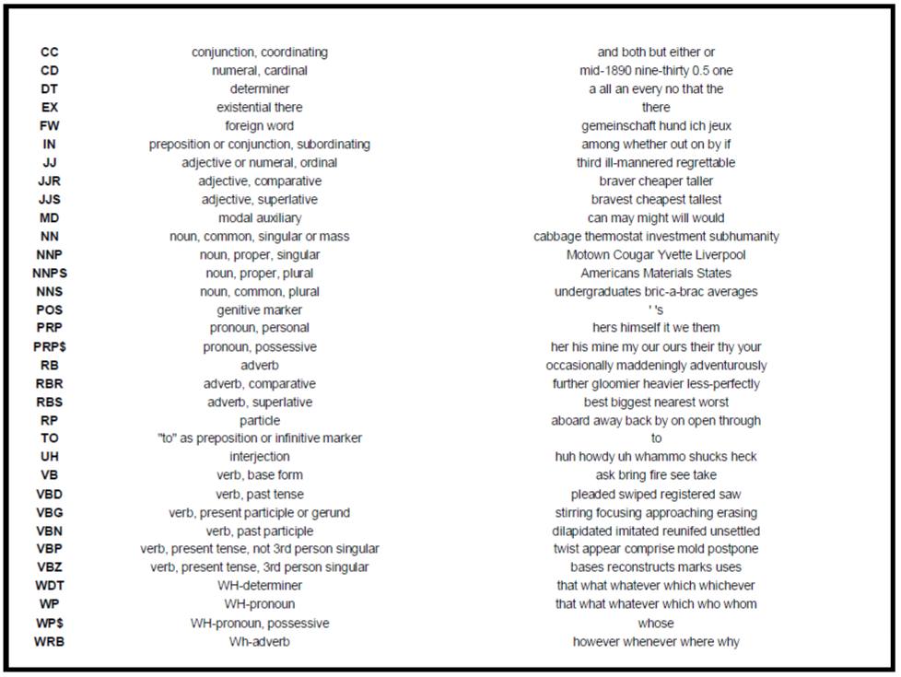
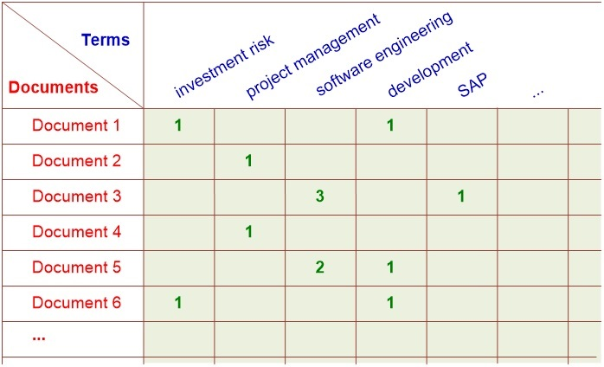
Text Mining Terminology
Term dictionary – a collection of terms specific to a narrow field that can be used to restrict the extracted terms within a corpus
Word frequency – # of times a word is found in a specific doc
Part-of-speech tagging – process of marking up the words in a text as corresponding to a particular part of speech based on a word’s def’n and the context in which it is used
Term-by-document matrix
Occurrence matrix
Singular value decomposition
A way of reducing the size of the TBD matrix

Slide 10
Natural Language Processing (NLP)
Structuring a collection of text
Old approach: bag-of-words
New approach: natural language processing
NLP is
a very important concept in text mining.
a subfield of artificial intelligence and computational linguistics.
the study of "understanding" the natural human language.
Syntax versus semantics based text mining
Word counting vs. understanding

Slide 11
Natural Language Processing (NLP)
What is “Understanding” ?
Human understands, what about computers?
Natural language is vague, context driven
True understanding requires extensive knowledge of a topic
Can/will computers ever understand natural language the same/accurate way we do?

Slide 12
Natural Language Processing (NLP)
Challenges in NLP
Part-of-speech tagging - is a word used as a verb/noun/adjective? It depends on how/where it is used. “Fire” in “The big fire truck.”
Text segmentation – some written languages (Chinese/Japanese/Thai – places with good food) do not have single word boundaries.
Slang/Urban Dictionary: I’m gonna do this.
Word sense disambiguation - words have more than one meaning
Syntax ambiguity – Fido saw the man on the mountain with a telescope.
Imperfect or irregular input – foreign or regional accents, vocal impediments
Speech acts – The word “Pass”
“Can you pass the class?”
“Can you pass the salt?”
Dream of AI community
to have algorithms that are capable of automatically reading and obtaining knowledge from text

Slide 13
Natural Language Processing (NLP)
WordNet
A laboriously hand-coded database of English words, their definitions, sets of synonyms, and various semantic relations between synonym sets
A major resource for NLP
Needs automation to be completed
Sentiment Analysis
A technique used to detect favorable and unfavorable opinions toward specific products and services
Application Case 5.6 for a CRM application

Slide 14
NLP Task Categories
Information retrieval – searching for relevant docs and generating metadata about the contents
Information extraction – automatically extract structured info
Named-entity recognition – locate and classify atomic elements in text into predefined categories such as names, organizations, locations, etc.
Question answering – produce a human-language answer when given a human-language question
Automatic summarization – create a shortened version of the doc

Slide 15
Case 5.6 – Whirlpool: Text Analytics
How did Whirlpool use capabilities of text analytics to better understand their customers and improve product offerings?
What were the challenges, the proposed solution, and the obtained results?

Slide 16
NLP Task Categories
Natural language generation & understanding
Machine translation – translate one human language into another
Foreign language reading & writing
Speech recognition – dictates spoken word to text file
Text proofing – detect and correct any errors in text files
Optical character recognition – automatic translation of images containing handwritten, typed or printed text into machine-editable text documents.

Slide 17
Text Mining Applications
Marketing applications
Enables better CRM, up-sell/cross-sell
Scan blogs /Social media: What do they like/dislike about a product?
Security applications
ECHELON, OASIS
Ability to identify content of telephone calls, faxes, emails via intercepted satellite transmissions and any other “public” medium.
Deception detection ~70% accuracy in just text of conversation
Biomedical
Literature-based gene identification
example coming up
Academic applications
Research stream analysis - example coming up

Slide 18
Text Mining Process
Context diagram for the text mining process

Slide 19
Text Mining Process
The three-step text mining process
Notes:
TD Term-Document Matrix

Slide 20
Text Mining Process
Step 1: Establish the corpus
Collect all relevant unstructured data
textual documents,
XML files,
emails,
Web pages,
short notes,
voice recordings
Digitize, standardize the collection - (e.g., all in ASCII text files)
Place the collection in a common place - (e.g., in a flat file, or in a directory as separate files)

Slide 21
Text Mining Process
Step 2: Create the Term–by–Document Matrix

Slide 22
Text Mining Process
Step 2: Create the Term–by–Document Matrix (TDM)
Should all terms be included?
Stop words, include words
Synonyms, homonyms
Stemming
What is the best representation of the indices (values in cells)?
Row counts; binary frequencies; log frequencies;
Inverse document frequency

Slide 23
Text Mining Process
Step 2: Create the Term–by–Document Matrix (TDM)
TDM is a sparse matrix. How can we reduce the dimensionality (size) of the TDM?
Manual – a domain expert goes through it
Eliminate terms with very few occurrences in very few documents

Slide 24
Text Mining Process
Step 3: Extract patterns/knowledge
Classification (text categorization)
Clustering (natural groupings of text)
Improve search recall
Improve search precision
Scatter/gather
Query-specific clustering
Association
Trend Analysis

Slide 25
Text Mining Application (research trend identification in literature)
Mining the published IS literature
MIS Quarterly (MISQ)
Journal of MIS (JMIS)
Information Systems Research (ISR)
Covers 12-year period (1994-2005)
901 papers are included in the study
Only the paper abstracts are used
9 clusters are generated for further analysis

Slide 26
Text Mining Application (research trend identification in literature)

Slide 27
Text Mining Application (research trend identification in literature)

Slide 28
Text Mining Application (research trend identification in literature)

Slide 29
Text Mining Tools
Commercial Software Tools
Semantria
SPSS PASW Text Miner
SAS Enterprise Miner
Statistica Data Miner
ClearForest
Free Software Tools
RapidMiner
GATE
Spy-EM

Slide 30
Chapter 5 Part 2

Slide 31
Big Data
Where/what/who do you think is the largest data repository on the planet?

Slide 32
Web Mining Overview
Web is the largest repository of data
Data is in HTML, XML, text format
Challenges (of processing Web data)
The Web is too big for effective data mining
The Web is too complex
The Web is too dynamic – pages being updated daily
The Web is not specific to a domain
The Web has everything… 99 percent of the information on the Web is useless to 99 percent of Web users.
Opportunities and challenges are great!

Slide 33
Web Mining
Web mining (or Web data mining) is the process of discovering intrinsic relationships from Web data (textual, linkage, or usage)

Slide 34
Web Content/Structure Mining
Mining of the textual content on the Web
Data collection via Web crawlers (aka spiders)
Web pages include hyperlinks
Authoritative pages
The more that a site is referenced, the more it is considered “the authority on the subject”
What about competitors?
What about paid ads?
Hubs: a webpage the provides collection of links to authoritative pages.
hyperlink-induced topic search (HITS) algorithm: a link-analysis algorithm that rates web pages using the embedded hyperlink information
Web Structure Mining: Links within a webpage may indicate the DEPTH of coverage of a specific topic.

Slide 35
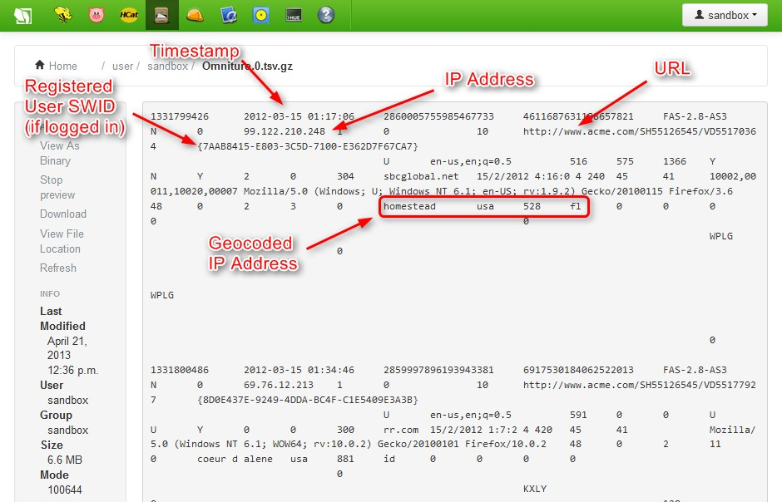
Web Usage Mining (Web Analytics)
Extraction of information from data generated through Web page visits and transactions
data stored in server access logs, referrer logs, agent logs, and client-side cookies
user characteristics and usage profiles
metadata, such as page attributes, content attributes, and usage data
Clickstream data
Clickstream analysis

Slide 36
Web Usage Mining
Web usage mining applications
Determine the lifetime value of clients
Design cross-marketing strategies across products.
Evaluate promotional campaigns
Target electronic ads and coupons at user groups based on user access patterns
Predict user behavior based on previously learned rules and users' profiles
Present dynamic information to users based on their interests and profiles

Slide 37
Web Usage Mining (clickstream analysis)

Slide 38
Web Analytics Metrics
Provides access to a lot of valuable marketing data.
Provide better insights into the data
Provides nearly real-time data which can document your marketing campaign successes
Empowers you to make timely adjustments to your marketing strategies
4 categories
Web site usability – How do they use the site?
Traffic sources – Where did they come from?
Visitor Profiles – What do my visitors look like?
Conversion statistics – what does it mean?

Slide 39
Website Usability
Page Views (avg/customer): low # could indicate poor design/structure or disconnect between marketing message and actual content
Time on site: the more the merrier unless they are hunting around aimlessly looking for something so compare this to page views
Downloads: definitely a good sign
Click Map: % of clicks each item on the page received. Are they clicking on the important items?
Click Paths: where are you losing customers? Are your success paths clear and pre-defined?

Slide 40
Traffic Sources
Referral web sites
Search engines: what key words drove traffic to your site and are they what you wanted? Creed
Direct:
QR Codes, URL manually entered into browser, commercials
Offline campaigns: directing visitors to a particular landing page that then determines how/why they arrived
Online campaigns: similar to offline just source may have been a banner add/email/search engine ad campaign

Slide 41
Visitor Profile
Keywords: segment your customers based upon search engine key words
Content groupings: allows you to analyze sections of your site devoted to sections of your business/org
Geography: Where are they? Do you have pockets of customers (on purpose/by accident)?
Time of day: what time of day are your visitors purchasing? Maybe staff customer service accordingly.
Landing page profiles: drive each of your targeted groups to a different landing page, which your Web analytics will capture and measure.

Slide 42
Conversion Statistics
A “conversion” is a goal/objective for a website.
A completed registration
A purchase
New visitors
Returning visitors: loyalty programs or products with a long sales cycle (where are they in the cycle?)
Leads: a form completed is a lead. How many leads convert to a sale
Sales/conversions: Monitoring this rate could alert you to good/bad situations.
Abandonment/exit rates: where did they give up?

Slide 43
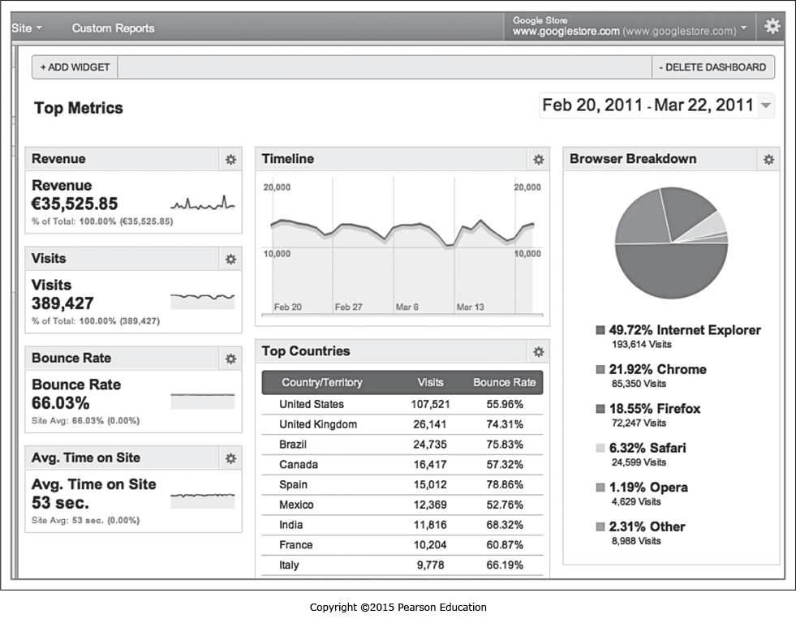

Slide 44
Web Mining Success Stories
Amazon.com, Ask.com, Scholastic.com, etc.
Website Optimization Ecosystem

Slide 45
Web Mining Tools

Slide 46
End of the Chapter
Questions, comments

